Slide 1
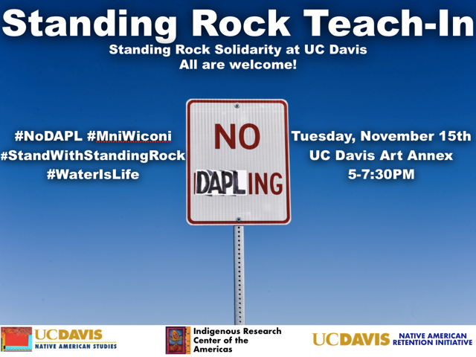

Slide 2
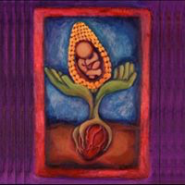
IRCA, Indigenous Research Center of the Americas
IRCA is a department-affiliated institute to promote scholarship and engagement with indigenous struggles for sovereignty, autonomy, and self-determination across the hemisphere. Since its founding in 1991, IRCA has served as forum for debate, opinion, information and reflection on the situation of indigenous peoples/Native Americans and their struggle for achieving higher levels of autonomy and securing a future of sovereignty and self-determination by:
• Serving as a nexus (whether virtual or physical) where communities, NGOs, social movements, tribal governments can connect with scholars and find support for movements for social transformation;
• Harnessing technology and new social media to foster community-driven research and reciprocal processes of experiential learning and engaged pedagogy;
• Repatriating and disseminating research to indigenous communities, scholars, and leaders; and
• Enriching the hemispheric focus of the department (via visiting scholars, student scholarships, field schools, colloquia, etc.).

Slide 3
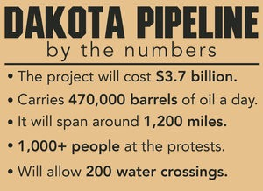
Bakken Pipeline
Energy Transfer Partners

Slide 4

Center for Biological Diversity
http://www.biologicaldiversity.org/campaigns/americas_dangerous_pipelines/index.html

Slide 5
Crude Oil Pipeline Incidents, 2010 to Present
http://www.foreffectivegov.org/blog/map-displays-five-years-oil-pipeline-spills

Slide 6
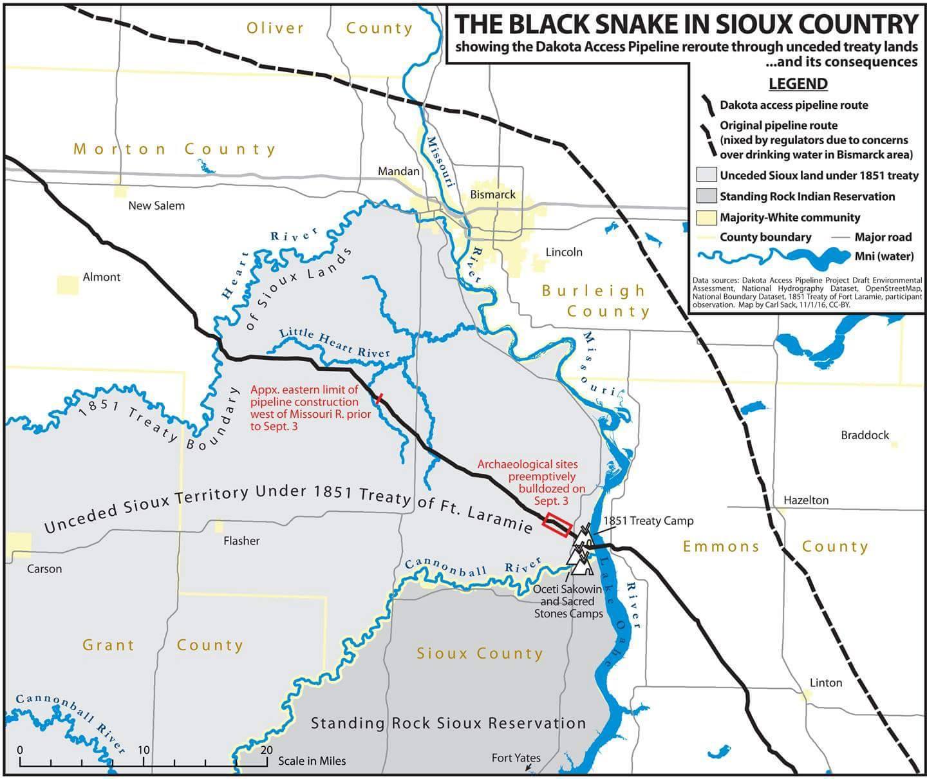

Slide 7
To move crude oil from the Bakken Oil Fields in North Dakota to connect with existing pipelines in Illinois

Slide 8
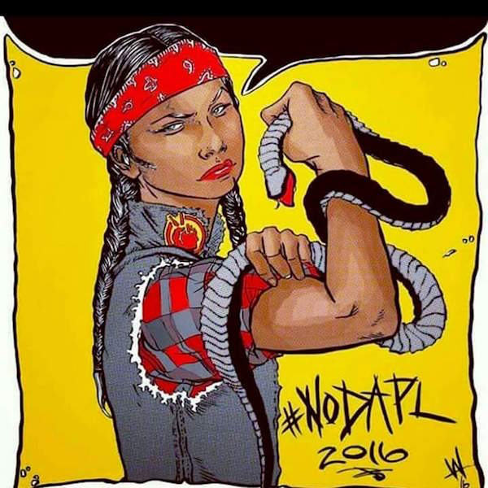
Lakota prophecy black snake
Clear violation of treaty land

Slide 9
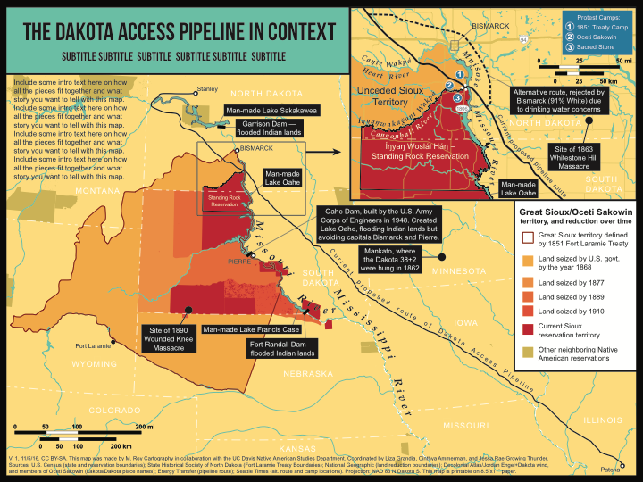
StandingRockMap_V1_110816

Slide 11
http://www.canku-luta.org/PineRidge/laramie_treaty.html

Slide 13
1851- Fort Laramie Treaty…. largest in history with Arapaho, Arikara, Assiniboine, Cheyenee, Crow, Hidatsa, Madan, and Sioux nations - “Great Sioux Reservation”
Dakota uprising 1862… in response to treaty violations, annuities not paid (during civil war) or stolen by traders (store debts), etc.
US Army took more than a thousand Dakota captive. With Lincoln’s approval, they hung 38 Dakota men in 1862, the largest mass execution in US history
September 3, 1863- General Sully attacked a village, killing 300 or more…Whitestone Massacre
Second Fort Laramie Treaty 1868, Article 2 gives Standing Rock Sioux “undisturbed use and occupation” of a permanent homeland, the Standing Rock Reservation

Slide 14
1874 - Custer violated treaty to discover gold in the Black Hills
By 1890, over half the original “Great Sioux Reservation” lost to allotment and white settlers
In 1889, divided into four reservations: Rosebud, Pineridge, Cheyenne River, Standing Rock
1948- Pick-Sloan dam planning —
1958 - Lands flooded by the Army Corps of Engineers….90% of timber, best range and irrigation lands, etc…. relocated in the middle of winter

Slide 16
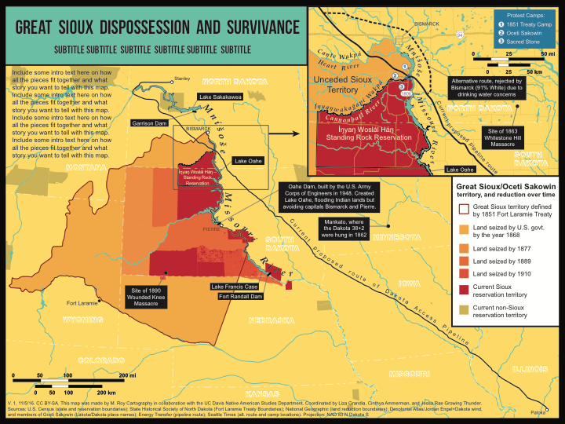
StandingRockMap_V1_110816

Slide 17
Chronology
April 1, 2016 - Sacred Stone Camp established on Ladonna Brave Bull Allard’s land
July 25, 2016 - after an EIA, Army Corps approves fast-track permit across 200 sites to finish the pipeline
August 4, 2016 - Standing Rock Sioux, with Earthjustice, filed an injunction against the Army Corps of Engineers
August 22, 2016 - protests to block construction sites at Cannon Ball, North Dakota
September 3, 2016 - DAPL deliberately plowed a 2-mile path through sacred burial grounds… just days before an anticipated court ruling
September 3, 2016 - a private security firm attached protectors with dogs and mace…captured by Democracy Now’s Amy Goodman. This is the anniversary of the 1863 “Whitestone Massacre” when the US Army killed >300 Standing Rock Sioux.

Slide 18
Chronology
September 8, 2016 - Gov. Jack Dalrymple called out the ND National Guard
September 9, 2016 - Standing Rock injection denied
September 23, 2016 - Standing Rock Chairman Davis Archambault II addressed the United Nations
Obama administration asked Energy Transfer Partners to halt construction until further assessment
October 9, 2016 - a district appeals court turned down the injunction…and again the Obama administration asked Energy Transfer Partners to pause.
October 11, 2016 - Actress Shailene Woodley streamed her arrest

Slide 19
Chronology
October 13, 2016 - Bernie Sanders + 4 other senators write President Obama. Amy Goodman says she would turn herself into authorities. [A judge eventually dropped the charges on 10/17/16.]
October 15, 2016 - more arrests
Obama administration asked Energy Transfer Partners to halt construction until further assessment
October 22, 2016 - 200-300 protectors pepper sprayed and attacked.
October 23, 2016 - some protectors move to Cannonball Ranch
Celebrities visit: Jesse Jackson, Mark Ruffalo, etc. When they leave, October 27, 2016, officers in full riot gear and tanks arrest 140+

Slide 20
Chronology
Two police departments refuse to re-deploy.
Trump elected
Construction continues unabated….2 weeks left
Protectors strip searched, held in dog kernels, shot with rubber bullets, maced while praying, etc.
October 23, 2016 - some protectors move to Cannonball Ranch
Celebrities visit: Jesse Jackson, Mark Ruffalo, etc. When they leave, October 27, 2016, officers in full riot gear and tanks arrest 140+

Slide 21
Chronology
October 28, 2016 - a herd of bison appear to protect the protectors from attack
October 28, 2016 - United Nations Permanent Forum on Indigenous Issues condemns the situation based on an appeal from tribal Chairman David Archambault
November 3, 2016 - 500 interdenominational clergy denounce the pipeline; 14 arrested

Slide 23
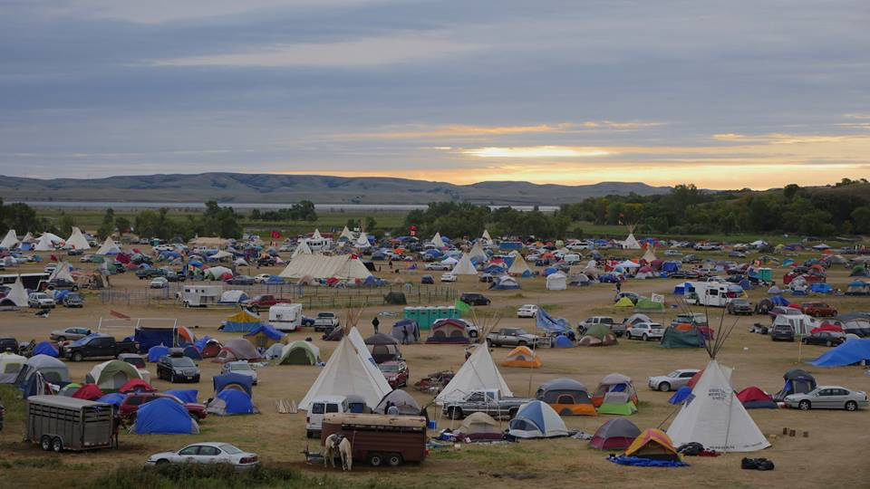

Slide 24
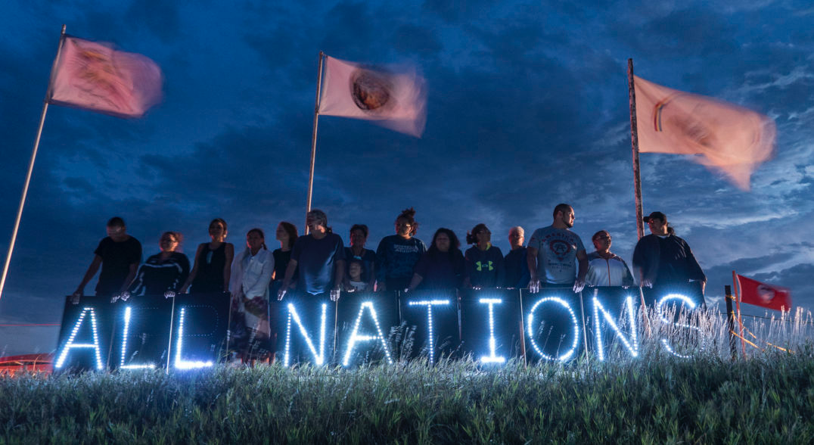
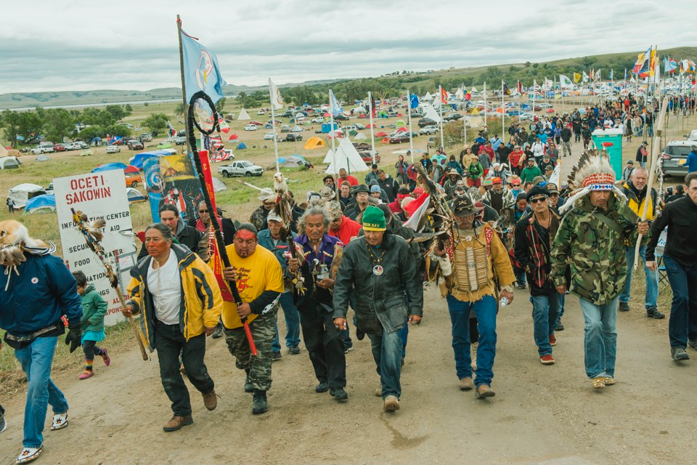

Slide 25
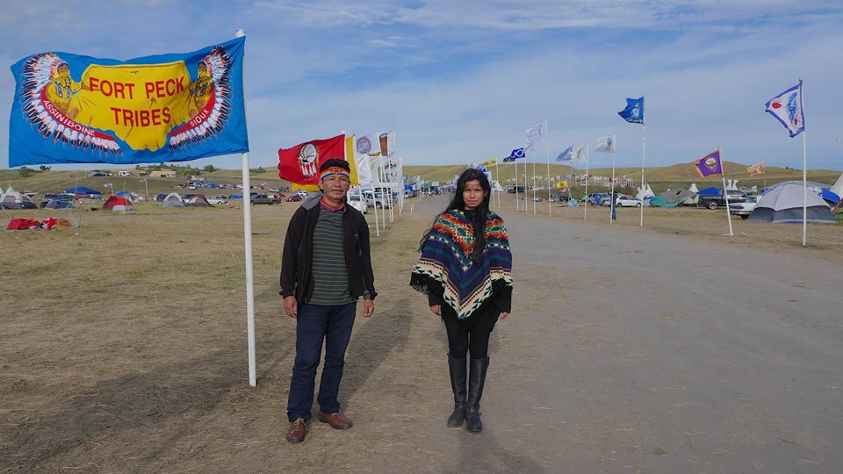

Slide 27
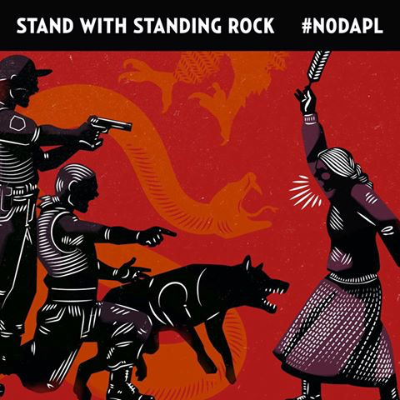
September 3, 2016

Slide 28
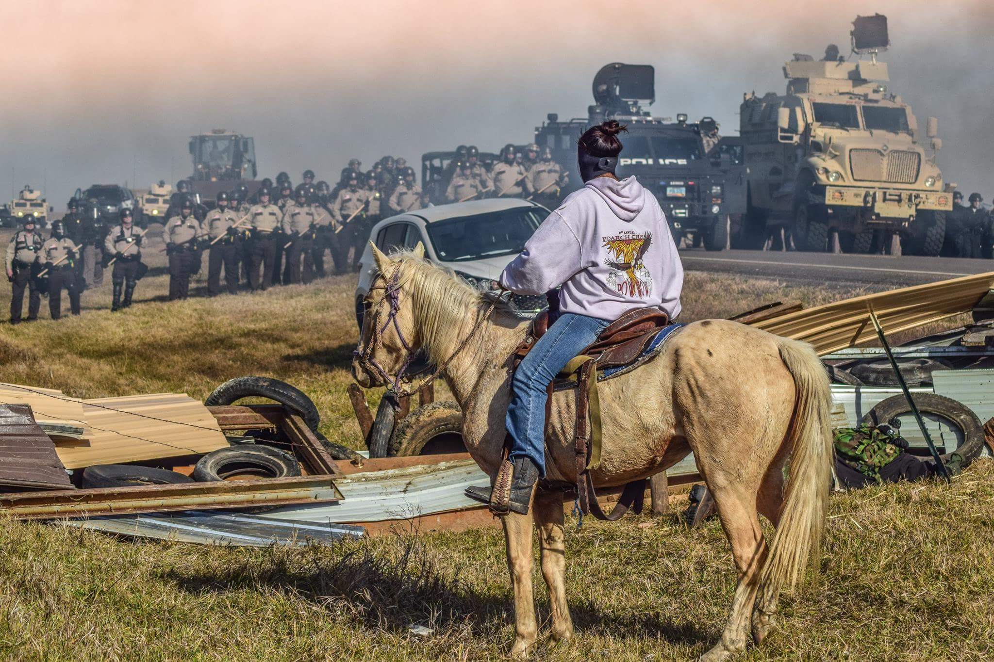

Slide 29
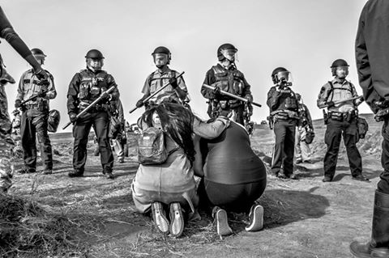

Slide 30
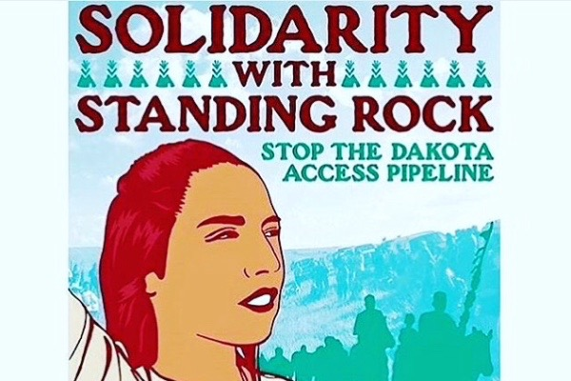

Slide 31

https://www.facebook.com/Caliscopemusic/photos/gm.1181637681882093/189250771481105/?type=3
https://www.facebook.com/events/1179643538748174/?acontext=%7B%22ref%22%3A%223%22%2C%22ref_newsfeed_story_type%22%3A%22regular%22%2C%22action_history%22%3A%22null%22%7D

Slide 32
Risling Room 3201 Hart Hall
Tuesdays - November 22, 4-6 pm
November 29, 4-6 pm
December 6, 4-6 pm

Slide 33
A. Fundraising / supplies / logistics / caravans / etc. (Growing Thunder)
B. Maps and websites (Ammerman)
- pins for event and solidarity actions
- teaching/journalist map
- petition clicker website
C. Translation corps - hemispheric connections (Grandia)
D. Letter writing - (Kelly)
E. Community organizing & direct action (Ferraya/Buxton)
F. Prayer, art, creative, social media, other (Sierra)

